Slide 1
CHAPTER 3
DERIVATIVES

Slide 2
CONTENTS
3.1. Derivatives
3.2. Derivative as a Function
3.3. Differentiation Formulae
3.4. Rates of Change in the Natural and Social Sciences
3.5. Derivatives of Trigonometric Functions
3.6. The Chain Rule
3.7. Implicit Differentiation
3.8. Derivatives of Logarithmic Functions
3.9. Related Rates
3.10. Linear Approximations and Differentials

Slide 3
3.5. DERIVATIVES OF TRIGONOMETRIC FUNCTIONS
Lemma 1.
T
Proof. We have
sinθ ≤⏐AB⏐≤ arc AB = θ
area(sector OAB) ≤ area (OAT)
i.e.
B
sinθ
θ
cosθ
A
Hence

Slide 4
Since cosθ → 1 as θ → 0, it follows from the
Squeeze Theorem
Lemma 2.
Proof.

Slide 5
Theorem.
Proof. We have

Slide 6
Similarly we have
Theorem. (Derivative of trigonometric functions)

Slide 7
Example. Differentiate
Solution. We have

Slide 8
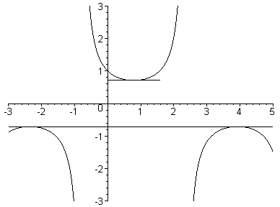
f’(x) = 0 when tanx = 1, i.e. x = π/4 + nπ, n ∈ Z

Slide 9
Example. An object at the end of a vertical spring is stretched 4 cm beyond its rest position and released at t=0. The position function is
s = f(t) = 4cost
Find the velocity and acceleration and analyze the motion of the object
Solution. We have

Slide 10
Analysis. The object oscillates from its lowest position (s=4) to the highest point (s=-4) with period 2π.
4cm

Slide 11
Analysis. The object oscillates from its lowest position (s=4) to the highest point (s=-4) with period 2π.

Slide 12
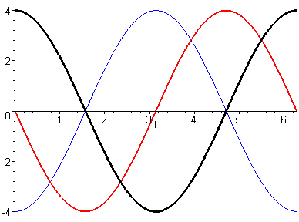
The speed is greatest when v = sint = 1, i.e. cost = 0:
This is the equilibrium point.
and it is 0 at the lowest and highest points.
On the contrary the acceleration is largest in magnitude at the lowest and highest points and becomes 0 at the equilibrium point

